Slide 1

Mastering Azure Cloud - Your Path to Certification
Suthahar Jegatheesan
Senior Application Specialist

Slide 2

Learning path 01―outline
You will learn the following concepts:
1
Cloud computing
World is going to the Cloud
Before cloud
Before cloud – Use case
Cloud
2
Azure Learning
Learning
3
Azure Certification
Certification

Slide 3

World is going to the Cloud
90% of Software Companies Use Cloud
Nearly $600 Billion in End-User Spending
Microsoft announces US$2.2 billion investment to fuel Malaysia’s cloud and AI transformation

Slide 4
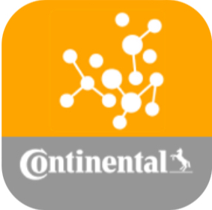
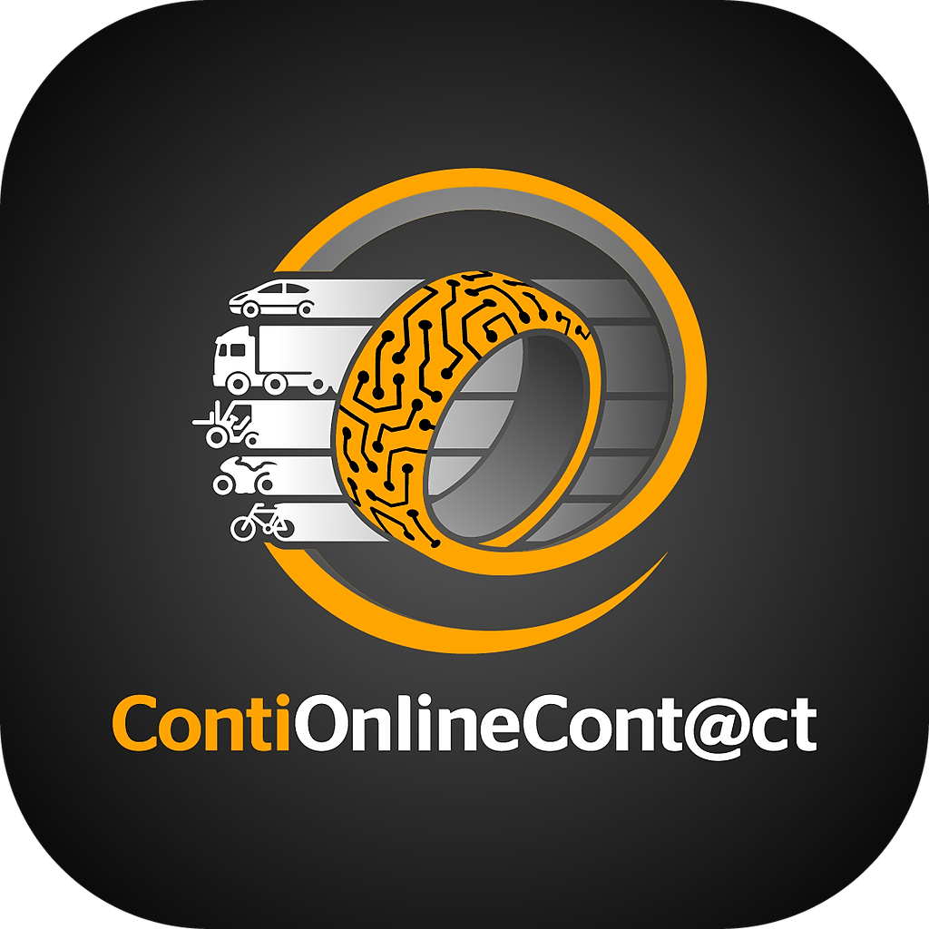



Conti Ecom cc – Cloud
CRM Mobile
ECHO
COC Web/ Mobile
Chat Bot App
Check-in App

Slide 5
Why Cloud?

Slide 6

Before the Cloud
If you needs server, you had to
Buy it
Install it
Maintain it
Replace it when it’s become old
Have own IT team

Slide 7
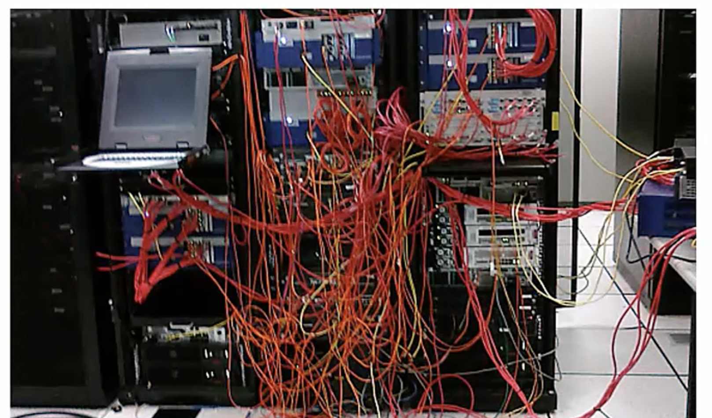
You often ended up with this
Networking
Database
User Management
And more ..

Slide 8




Year End Sale
Jan
Feb
March
April
May
June
July
Aug
Sep
Oct
Nov
60%
To 120%

Slide 9


Slide 10
Year End Sale
Jan
Feb
March
April
May
June
July
Aug
Sep
Oct
Nov
20%
To 90 %

Slide 11

Bought
CPU %
Used
Time %
Time %

Slide 12



The Cloud
Computer, Networking, Storage and other services Managed by SOMEONE else
Compute
Networking
Storage

Slide 13
Cloud Providers
Companies(Microsoft, Amazon) who build huge data centres
Fill it with servers, networking,
cooling, electricity etc.
Design and install various services
Make it publicly accessible

Slide 14
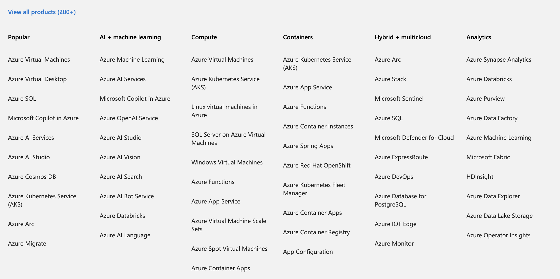
Cloud Service
Notes:
https://learn.microsoft.com/training/modules/describe-benefits-use-cloud-services/1-introduction

Slide 15
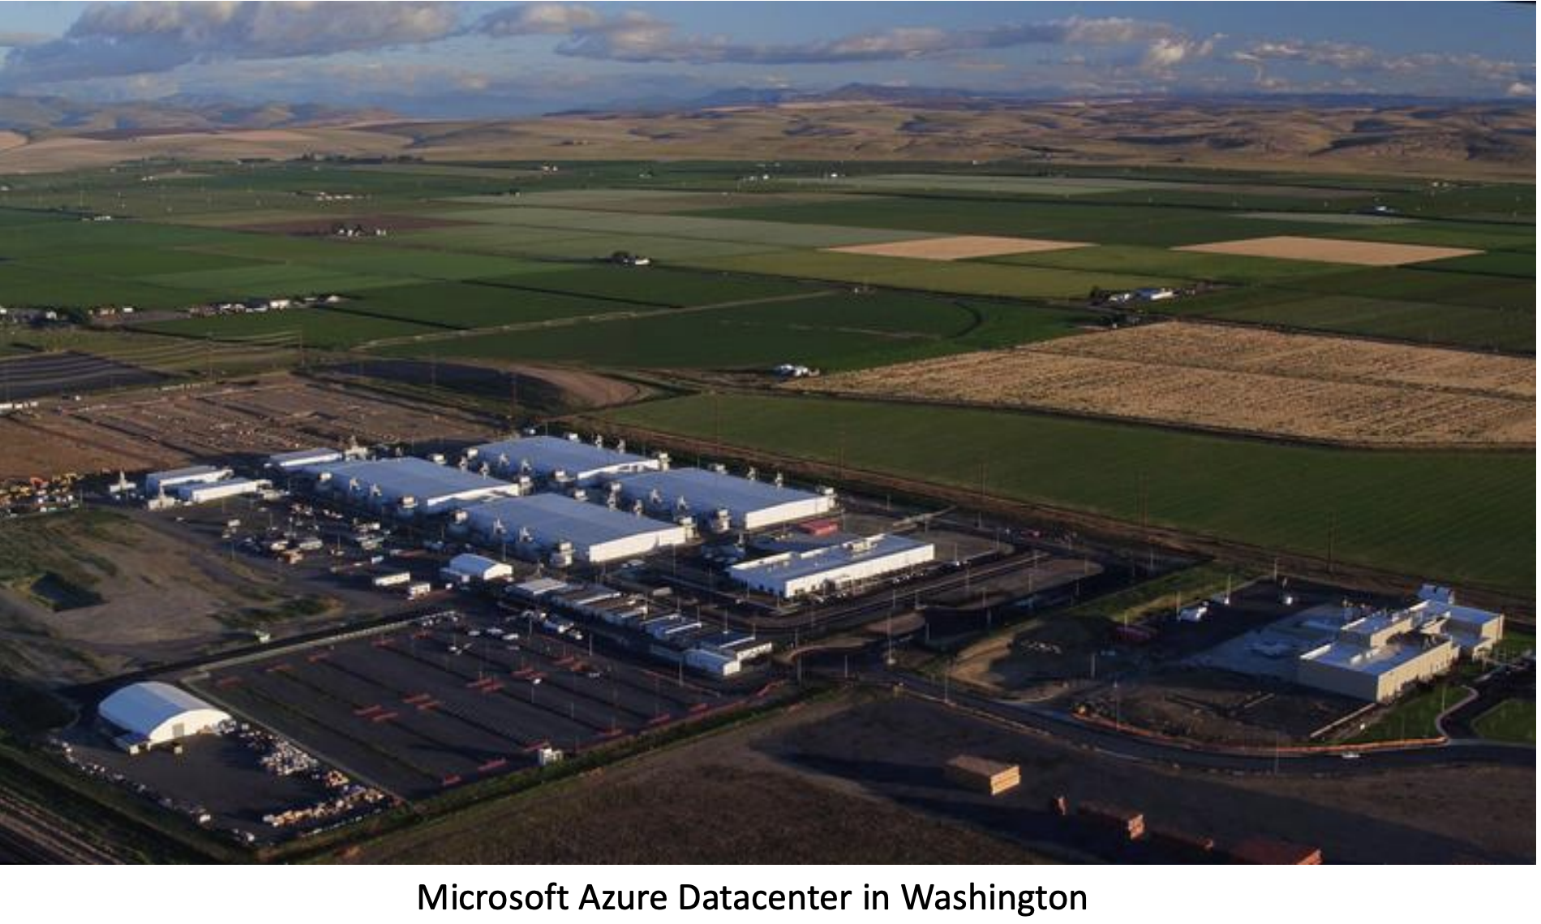
DataCenter

Slide 16
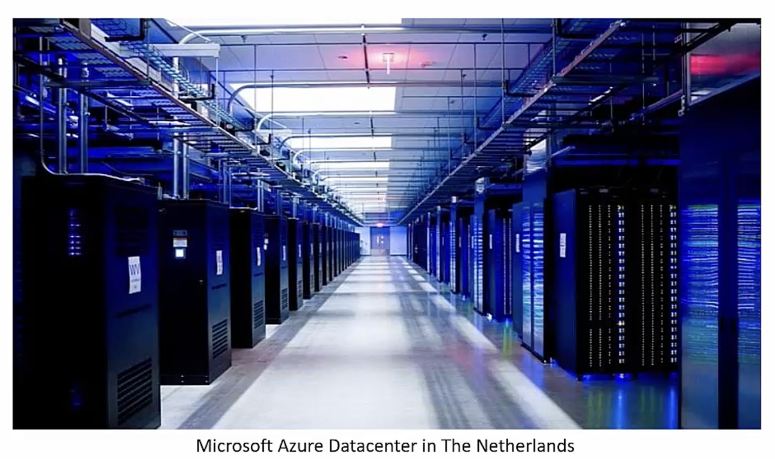
Azure DataCenter Inside View
100k physical Server /Datacenter

Slide 17
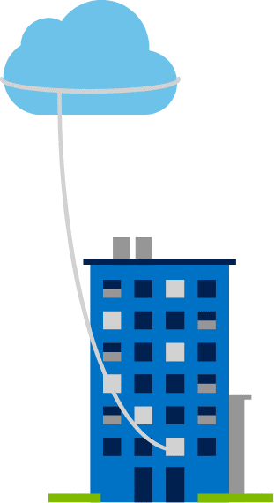
Private cloud
Organizations create a cloud environment in their datacenter.
Organizations are responsible for operating the services they provide.
Does not provide access to users outside of the organization.
Notes:
https://learn.microsoft.com/training/modules/describe-cloud-compute/5-define-cloud-models
Owned and operated by the organization that uses cloud resources.
Organizations create a cloud environment in their datacenter.
Self-service access to compute resources provided to users within the organization.
Organizations are responsible for operating the services they provide.

Slide 18
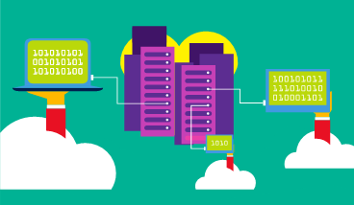
Public cloud
Owned by cloud services or hosting provider.
Provides resources and services to multiple organizations and users.
Accessed via secure network connection (typically over the internet).
Notes:
https://learn.microsoft.com/training/modules/describe-cloud-compute/5-define-cloud-models
What are public, private, and hybrid clouds? - https://azure.microsoft.com/resources/cloud-computing-dictionary/what-are-private-public-hybrid-clouds/

Slide 19
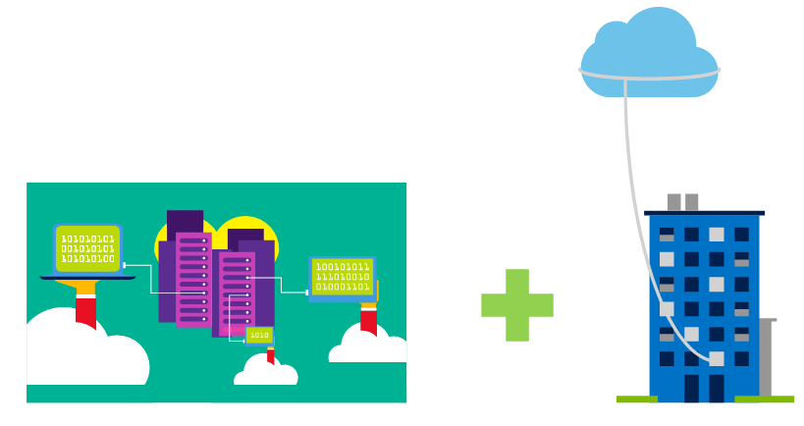
Hybrid cloud
Combines public and private clouds to allow applications to run in the most appropriate location.
Notes:
https://learn.microsoft.com/training/modules/describe-cloud-compute/5-define-cloud-models
Hybrid cloud models have the following characteristics:
Resource location. Specific resources are run or used in a public cloud―others are run or used in a private cloud.
Cost and efficiency. Hybrid cloud models allow an organization to leverage some of the benefits of cost, efficiency, and scale that are available with a public cloud model.
Control. Organizations retain management control in private clouds.
Skills. Technical skills are still required to maintain the private cloud and ensure both cloud models can operate together.

Slide 20
Azure VS AWS
AWS:Launched in 2006
Largest market share
Broad adoption across various industries
Pay-as-you-go, reserved instances, savings plans, spot instances
Azure:Launched in 2010
Second-largest market share
Strong presence in the enterprise sector
Pay-as-you-go, reserved instances, spot pricing

Slide 21
Learning and Certification
Notes:
https://learn.microsoft.com/training/modules/describe-cloud-service-types

Slide 22
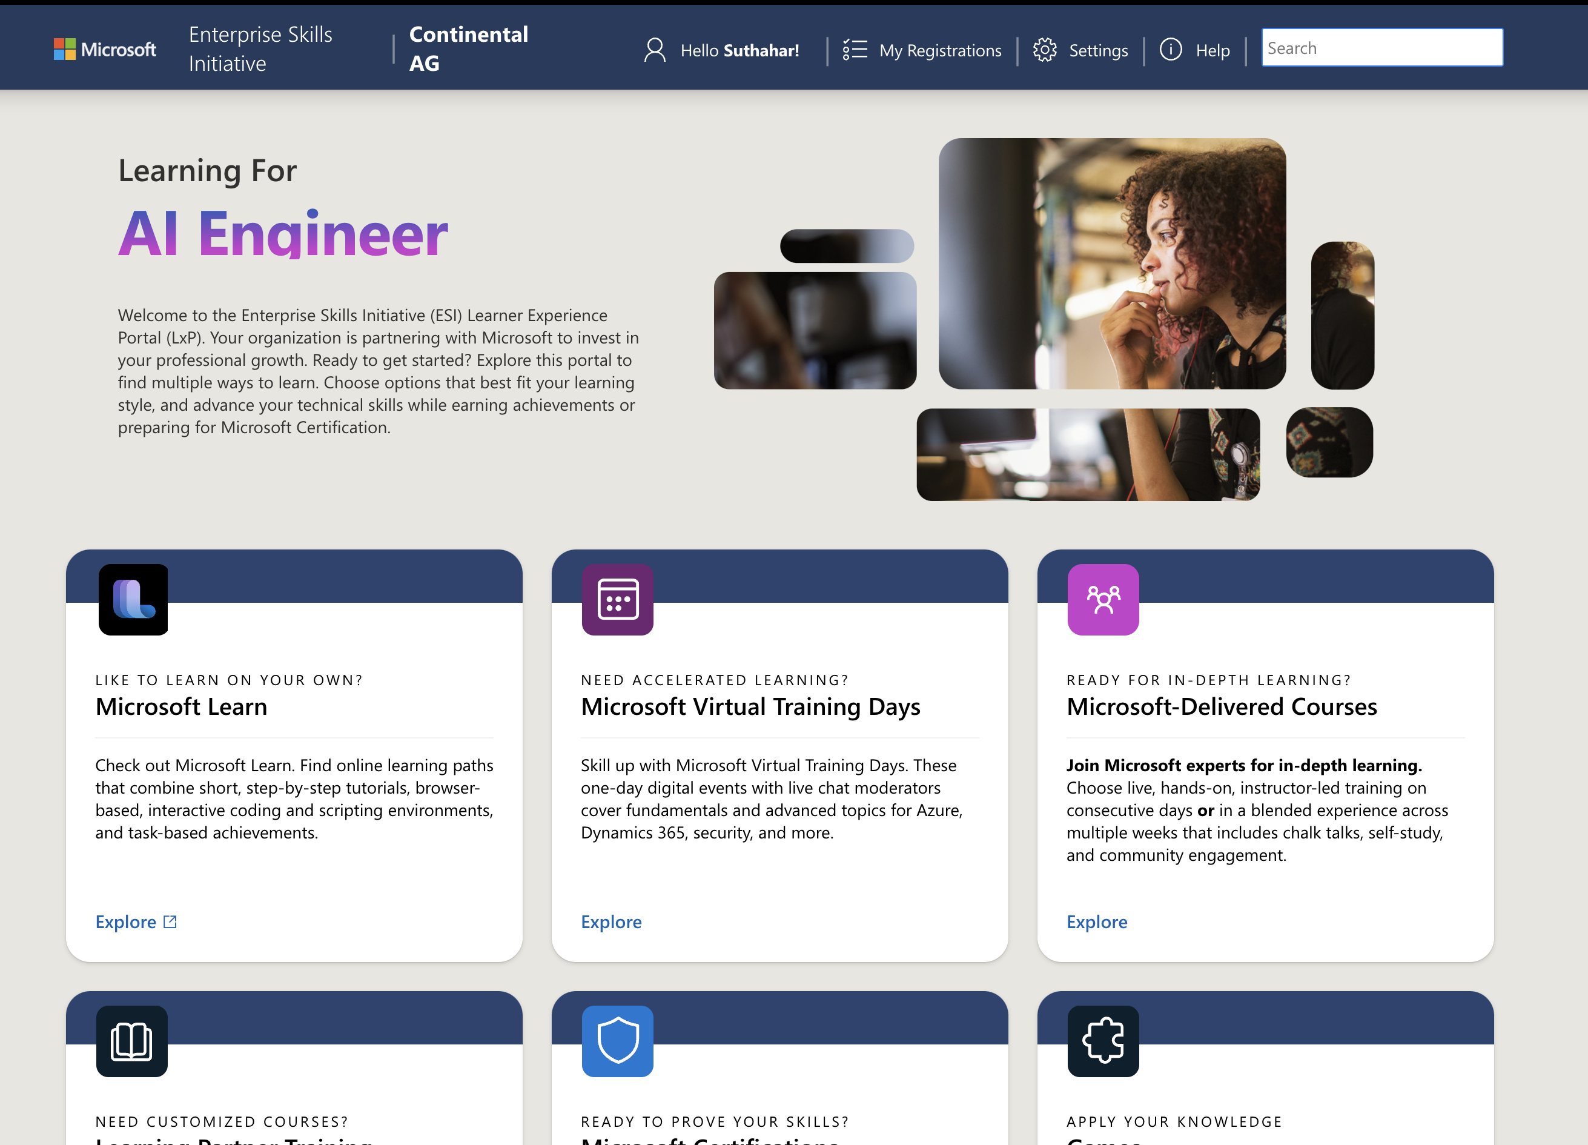

Slide 23
Upcoming

Slide 24
Azure Sandbox environment
Create an Azure Free Account – Portal.azure.com
Set Up a Free Subscription
Set Up the Sandbox Environment for Learning
Explore and Learn

Slide 25
Cloud Computing Services | Microsoft Azure
Browse all courses, learning paths, and modules - Training | Microsoft Learn
Microsoft Certified: Azure Fundamentals - Certifications | Microsoft Learn

Slide 26
Cloud Computing Services | Microsoft Azure

